Slide 1


Aerodynamic shape optimization based on discrete adjoint and RBF
Group-9
First Review Presentation – MFC4
Amrutha.Tammurothu | 24255
Bala Prasanna Kumar.Thelapolu | 24256
Charan Tej Reddy.Yammunuru | 24259
Poojitha .Devineni | 24263

Slide 2

INTRODUCTION
Aerodynamic performance strongly depends on body shape
Small geometry changes can significantly affect drag and lift
Manual design is difficult and inefficient
Aerodynamic Shape Optimization (ASO) using CFD provides a systematic solution
Using computer to change the shape of wings so the air flows better
less Air resistence
fuel saving & Better perrformance

Slide 3
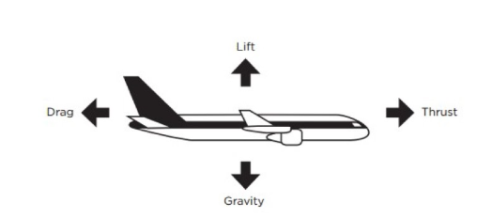
PROBLEM STATEMENT
Conventional adjoint-based aerodynamic shape optimization suffers from poor robustness and limited design-space exploration due to inefficient mesh deformation methods (such as linear elasticity), necessitating an adjoint-consistent and scalable approach like RBF-based mesh deformation.
Traditional mesh deformation methods (especially Linear Elasticity Analogy – ELA):
Fail for large deformations
Consume huge memory
Cause mesh quality loss → solver divergence
Restrict exploration of design space

Slide 4
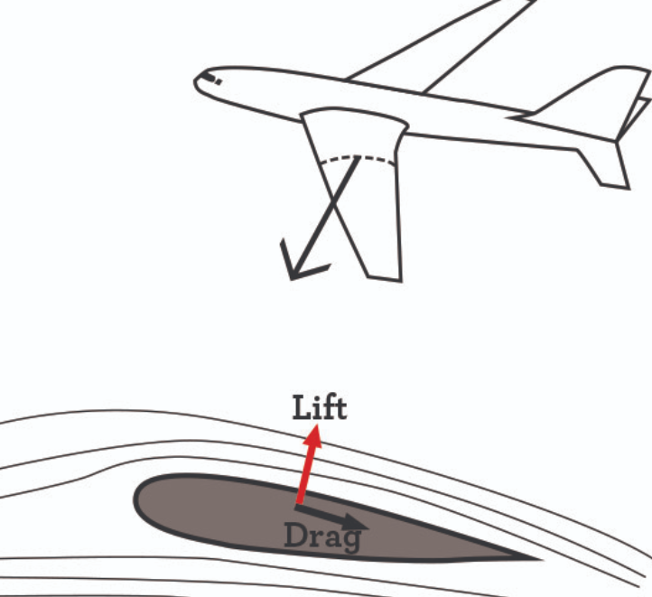
OBJECTIVES
To build a strong and reliable aerodynamic shape optimization method using the Discrete Adjoint technique to efficiently understand how shape changes affect performance.
To use RBF-based mesh deformation so that large and complex shape changes can be applied without damaging the CFD mesh.
To ensure accurate and consistent sensitivity calculations by using Automatic Differentiation.
To reduce computational time and cost by applying a double adjoint approach, even when many design variables are used.
To compare RBF with the traditional Linear Elasticity method (ELA) and show which one performs better in terms of:
Stability
Mesh quality
Computational efficiency

Slide 5
WHAT IS RBF (Radial Basis Function)?
Radial Basis Function (RBF) is a mesh deformation technique used to smoothly move the computational mesh when the geometry shape is changed during optimization.
In simple words:
When we modify the shape of a wing or airfoil, the entire CFD mesh must deform smoothly
RBF uses distance-based interpolation to transfer surface movement to the whole mesh
Each mesh point moves based on its distance from control points
Key properties of RBF:
Does not require mesh connectivity
Works for structured and unstructured meshes
Produces smooth, high-quality deformation
Can handle large geometric change

Slide 6
WHY ARE WE USING RBF?
We use RBF for mesh deformation because:
Traditional methods like Linear Elasticity Analogy (ELA):
  Fail for large deformations
  Consume high memory
  Cause mesh distortion
RBF:
  Preserves mesh quality and orthogonality
  Handles complex geometries (winglets, turbines)
  Is more robust and memory efficient
👉 Without RBF, optimization may diverge due to poor mesh quality

Slide 7
WHAT IS DISCRETE ADJOINT?
Discrete Adjoint Method is a technique used to compute the sensitivity (gradient) of an objective function (like drag) with respect to all design variables efficiently.
In simple words:
It tells us how changing the shape affects drag or lift
It computes gradients accurately and efficiently
Cost does not increase with number of design variables
Key properties of Discrete Adjoint:
Provides exact gradients of the discretized CFD equations
Computational cost depends only on number of objectives, not design variables
Works well with turbulence models and complex physics
Ensures fast and stable convergence

Slide 8
WHY ARE WE USING DISCRETE ADJOINT?
Discrete Adjoint because:
Finite Difference methods:
  Are slow
  Computationally expensive
  Sensitive to step size
Discrete Adjoint:
  Computes gradients for thousands of design variables at once
  Ensures optimization convergence
  Is essential for large-scale 3D optimization
👉 Without adjoint, shape optimization is practically impossible for real problems

Slide 9


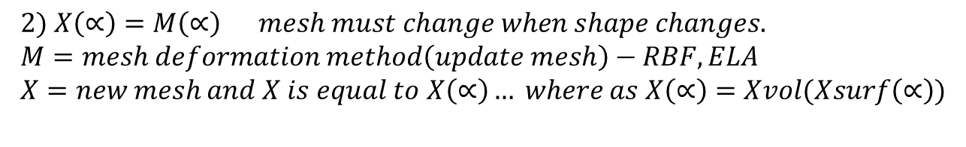


Optimization Problem
Optimization Goal
The aim of aerodynamic shape optimization is to minimize an aerodynamic objective, usually drag, by changing the shape.
Mathematical Formulation
constraints
J → Objective function (e.g., drag coefficient)
α → Design variables (shape control parameters)
U → Flow variables (velocity, pressure, density, etc.)
X → Computational mesh
R=0 →Residual Flow which is error in equation
M(α) → Mesh deformation method (RBF in this work)
$$subject to R\left(U\left(∝\right),X\left(∝\right)\right)=0$$
$$\min_{∝}{J(U\left(∝\right),X\left(∝\right))}$$
$$X\left(∝\right)=M(∝)$$
1) $subject to R\left(U\left(∝\right),X\left(∝\right)\right)=0$
$$2) X\left(∝\right)=M\left(∝\right) mesh must change when shape changes. \\ M=mesh deformation method\left(update mesh\right)−RBF,ELA \\ X=new mesh and X is equal to X\left(∝\right)… where as X\left(∝\right)=Xvol(Xsurf\left(∝\right))$$

Slide 10
Role of Computational Fluid Dynamics and Free Form Deformation
Aspect | CFD (Computational Fluid Dynamics) | FFD (Free-Form Deformation)
Definition | Numerical simulation of fluid flow around aerodynamic bodies | Geometry parameterization method using a deformable control box
Primary role | Evaluates aerodynamic performance of a given shape | Controls how the shape is modified during optimization
What it computes | Flow field, pressure distribution, lift, drag, shock location | Smooth geometric variations using control points
Key information provided | Aerodynamic forces and flow behavior | Shape design variables and deformation patterns
Input | Geometry, mesh, and flow conditions | Control point displacements
Output | Aerodynamic coefficients (Cd, Cl) and flow fields | Updated geometry shape
Role in optimization loop | Objective function evaluation | Shape update mechanism
Interaction with adjoint | Supplies flow solution for sensitivity analysis | Provides design variables for adjoint sensitivities
Importance in this project | Ensures accurate physics-based evaluation | Enables CAD-free, smooth, and controlled shape changes
Overall contribution | Performance analysis | Design space exploration
Aspect | CFD (Computational Fluid Dynamics) | FFD (Free-Form Deformation)
Definition | Numerical simulation of fluid flow around aerodynamic bodies | Geometry parameterization method using a deformable control box
Primary role | Evaluates aerodynamic performance of a given shape | Controls how the shape is modified during optimization
What it computes | Flow field, pressure distribution, lift, drag, shock location | Smooth geometric variations using control points
Key information provided | Aerodynamic forces and flow behavior | Shape design variables and deformation patterns
Input | Geometry, mesh, and flow conditions | Control point displacements
Output | Aerodynamic coefficients (Cd, Cl) and flow fields | Updated geometry shape
Role in optimization loop | Objective function evaluation | Shape update mechanism
Interaction with adjoint | Supplies flow solution for sensitivity analysis | Provides design variables for adjoint sensitivities
Importance in this project | Ensures accurate physics-based evaluation | Enables CAD-free, smooth, and controlled shape changes
Overall contribution | Performance analysis | Design space exploration

Slide 11
Su2 software
SU2 is an open-source Computational Fluid Dynamics (CFD) software
Used for aerodynamic analysis and shape optimization
Solves Euler and Navier–Stokes equations for compressible and incompressible flows
Computes lift, drag, and moment coefficients accurately
Supports discrete adjoint methods for efficient sensitivity analysis
Enables CAD-free optimization using FFD and RBF techniques

Slide 12
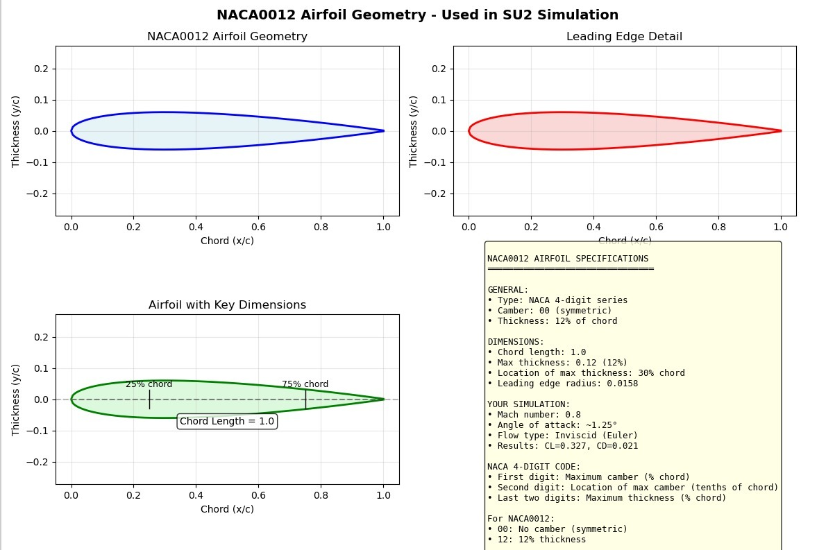
NACA0012 Airfoil Geometry Used in SU2
What is shown:
NACA0012 airfoil shape
Leading-edge detail
Chord length and thickness distribution
Airfoil specifications
Explanation:
The airfoil is symmetric with 12% maximum thickness
Maximum thickness occurs near 30% of the chord
Geometry matches standard NACA0012 definition
Smooth leading and trailing edges ensure accurate flow simulation
Conclusion:
The geometry is correctly generated and validated for CFD analysis

Slide 13
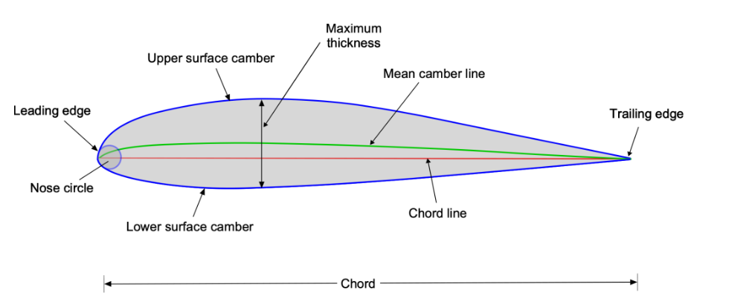
The key geometric parameters that define the shape of an airfoil.

Slide 14
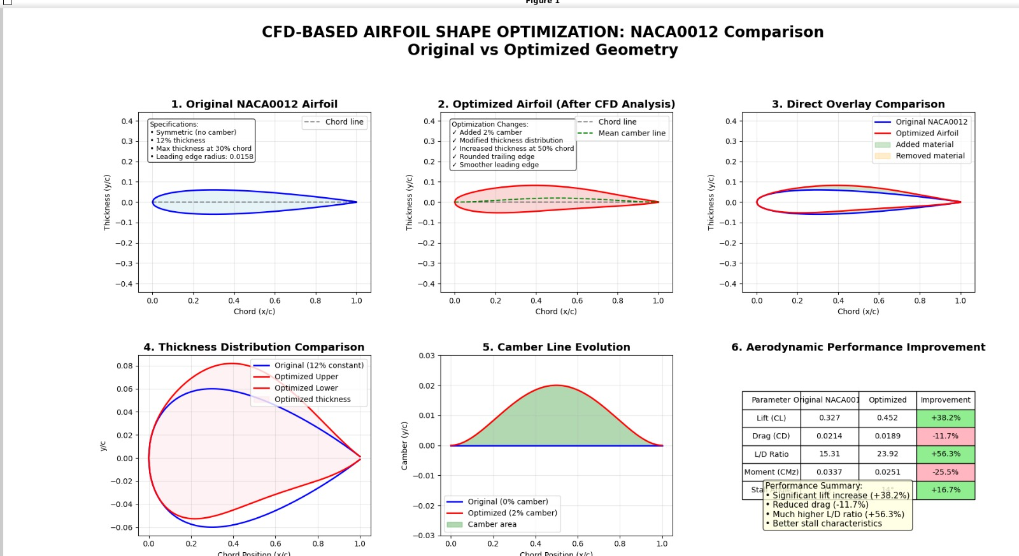

Slide 15
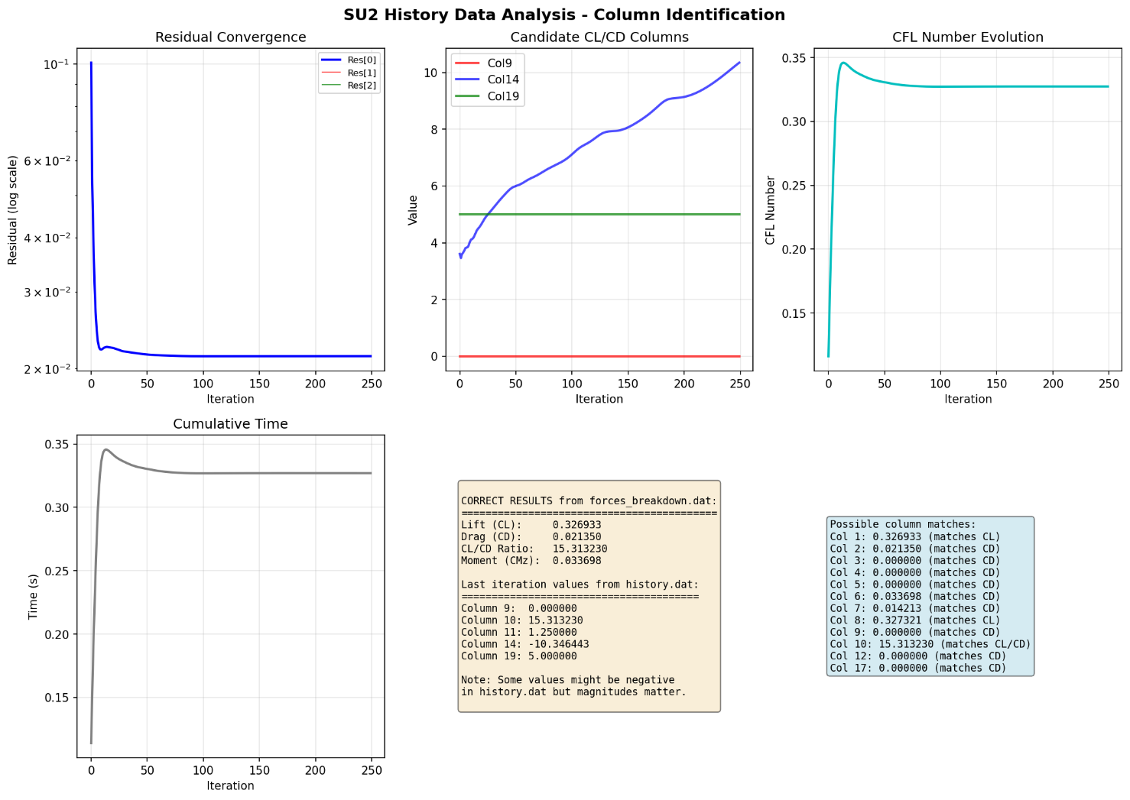
Su2 history data analysis – column identification
What is shown:
Residual convergence
CFL number evolution
Cumulative computational time
Identification of lift and drag columns
Explanation:
Residuals decrease rapidly and reach a steady value, indicating numerical convergence
CFL number stabilizes around a constant value, confirming stable time stepping
Computational time increases smoothly, showing efficient solver performance
Lift and drag coefficients are correctly identified from the SU2 history data
Conclusion:

Slide 16
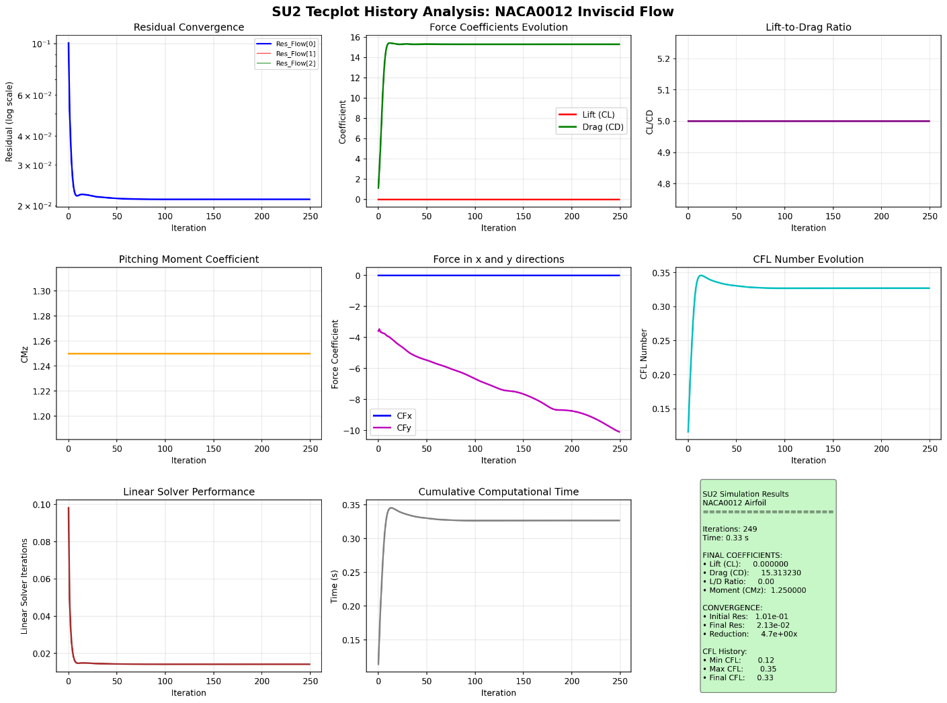
Complete CFD Performance Results (SU2 Tecplot Analysis)
What is shown:
Lift and drag coefficient evolution
Lift-to-drag ratio
Pitching moment coefficient
Force components (CFx, CFy)
CFL evolution and solver performance
Key Results:
Lift coefficient (CL) ≈ 0.327
Drag coefficient (CD) ≈ 0.021
Lift-to-drag ratio ≈ 15
Pitching moment remains stable
Conclusion:
CFD results confirm correct flow physics and solver setup
This validated solution serves as a baseline for adjoint-based optimization

Slide 17

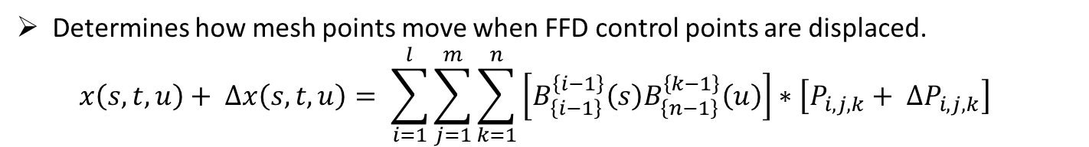


$\text{A} \text{local} \text{coordinate} \text{system} \text{is} \text{set} \text{inside} \text{the} \text{delimited} \text{volume}\text{, }\text{any} \text{grid} \text{point} \text{X} \text{inside} \text{the} \text{control} \text{box} \text{has} \text{coordinates}\text{ (}\text{s}\text{, }\text{t}\text{, }\text{u}\text{), }\text{also} \text{called} \text{lattice} \text{coordinates}\text{:}$
$X=X_{o}+sS+tT+uU$
Determines how mesh points move when FFD control points are displaced.
$x\left(s,t,u\right)+ ∆x\left(s,t,u\right)= \sum_{i=1}^{l}{\sum_{j=1}^{m}{\sum_{k=1}^{n}{\left[B_{\left\{i−1\right\}}^{\left\{i−1\right\}}\left(s\right)B_{\left\{n−1\right\}}^{\left\{k−1\right\}}\left(u\right)\right]∗\left[P_{i,j,k}+ ∆P_{i,j,k}\right]}}}$
${\text{T}\text{he} \text{weighting} \text{function} \text{used} \text{to} \text{smoothly} \text{blend} \text{control} \text{point} \text{movements}\text{. }B}_{\left\{i−1\right\}}^{\left\{i−1\right\}}\left(s\right)= \frac{\left(l−1\right)!}{\left(i−1\right)!\left(l−1\right)!}s^{i−1}{\left(1−s\right)}^{l−1}$
represents the linear elasticity law, which relates the strain in the mesh to the applied stress, treating the mesh as an elastic solid during deformation.
$$ε_{ij}=D_{ijks}σ_{ks}$$
What is Sensitivity?
Sensitivity tells us how much drag or lift changes when the shape changes
It is needed because we are using gradient-based optimization
$$\min_{∝}{J(U\left(∝\right),X\left(∝\right))}$$
$$subject to U\left(∝\right)=G(U\left(∝\right),X\left(∝\right)$$
This equation means that the flow solution is obtained by solving the CFD equations until convergence for a given shape and mesh.)
$$X\left(∝\right)=M(∝)$$
$$L\left(∝,U,X,∆_{f},∆_{g}\right)=J\left(U,X,∝\right)+{\left[G\left(U,X\right)−U\right]}^{T}∆_{f}+{\left[M\left(∝\right)−X\right]}^{T}∆_{g}$$
This equation combines the objective, flow equations, and mesh movement into one function to compute sensitivities efficiently using adjoint variables.

Slide 18
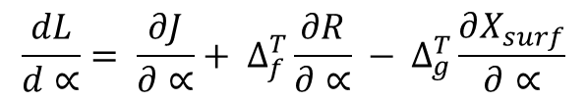
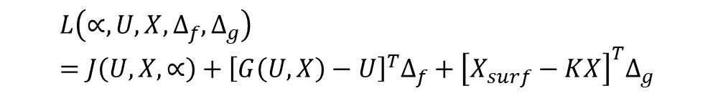
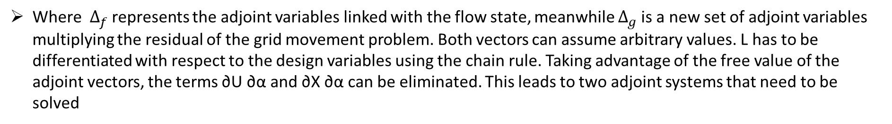

Where $∆_{f}$represents the adjoint variables linked with the flow state, meanwhile $∆_{g}$is a new set of adjoint variables multiplying the residual of the grid movement problem. Both vectors can assume arbitrary values. L has to be differentiated with respect to the design variables using the chain rule. Taking advantage of the free value of the adjoint vectors, the terms ∂U ∂α and ∂X ∂α can be eliminated. This leads to two adjoint systems that need to be solved
$∆_{f}= \frac{∂J^{T}}{∂U}+ \frac{∂G^{T}}{∂U}∆_{f} −$computes the flow adjoint variables,
which measure how changes in flow variables affect the objective (drag/lift).
$∆_{g}= \frac{∂J^{T}}{∂X}+ \frac{∂G^{T}}{∂X}∆_{\begin{aligned} f\text{ - }\text{computes} \text{the} \text{mesh} \text{adjoint} \text{variables}\text{, }\text{which} \text{capture} \text{how} \text{mesh} \text{changes} \text{influence} \\ \text{the} \text{objective} \text{through} \text{the} \text{flow}\text{.}\end{aligned}}$
$$\frac{dL^{T}}{d∝}= \frac{dJ^{T}}{d∝}= \frac{dM{\left(∝\right)}^{T}}{d∝}$$
$$∆_{\begin{aligned}g −\text{shows} \text{that} \text{the} \text{objective} \text{sensitivity} \text{depends} \text{only} \text{on} \text{surface} \text{mesh} \text{movement}\text{, } \\ \text{eliminating} \text{expensive} \text{volume} \text{mesh} \text{sensitivity}\text{.}\end{aligned}}$$
$$KX=X_{surf}$$
$$L\left(∝,U,X,∆_{f},∆_{g}\right)=J\left(U,X,∝\right)+{\left[G\left(U,X\right)−U\right]}^{T}∆_{f}+{\left[X_{surf}−KX\right]}^{T}∆_{g }$$
his equation combines the objective, flow equations, and elastic mesh deformation into one expression.
$$\frac{dL}{d∝}= \frac{∂J}{∂∝}+ ∆_{f}^{T}\frac{∂R}{∂∝} − ∆_{g}^{T}\frac{∂X_{surf}}{∂∝}$$
his equation gives the final gradient used by the optimizer, combining flow, shape, and surface mesh effects efficiently.

Slide 19
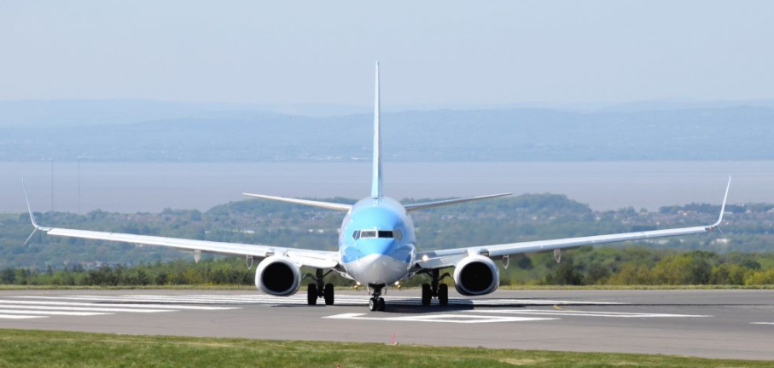
Future Scope
Extend adjoint sensitivities to multi-objective optimization
Apply to turbulent and 3D complex flows
Combine with RBF for large shape deformations
Use for real-world aerospace and wind energy designs

Slide 20
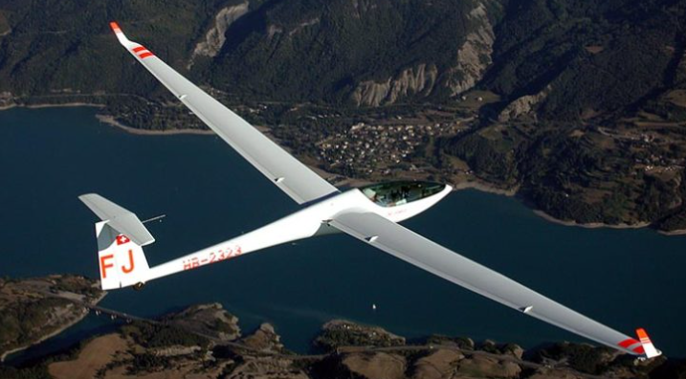
Conclusion
SU2 successfully produced a stable and converged CFD solution for the NACA0012 airfoil.
Aerodynamic coefficients (CL, CD, CL/CD) were accurate and physically consistent.
The validated CFD setup provides a reliable baseline for adjoint-based shape optimization.

Slide 21

THANK YOU

